Slide 1
Research Project Workshop 02:
Research Data Management (RDM) Overview
March15, 2017
Instructor: Letisha Wyatt, PhD

Slide 2
agenda & learning outcomes
1 Understand the elements of the data life cycle
2 Describe fundamental processes of research
data management (RDM)
3 Identify the components of a data
management plan and construct a draft

Slide 3
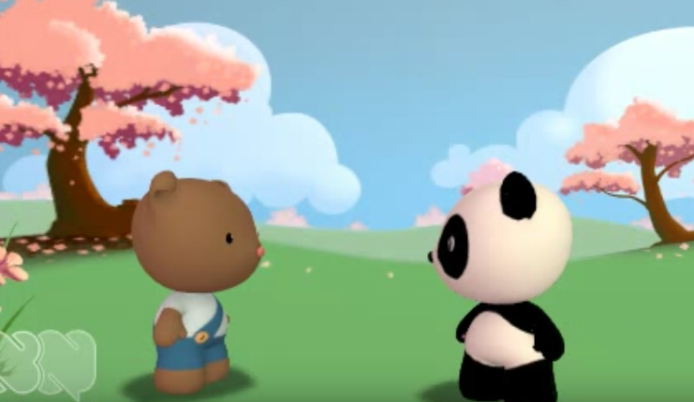
why is data tlc important?
Source: NYU Health Sciences Library

Slide 4
how about your
data-related activities?

Slide 5
research/data life cycles
Research Life Cycle
Data Discovery
Data
Archive
Re-Use
Plan
Repository
Discover
Collect
Planning
Proposal
Writing
Project
Start
Assure
Project End
Share
Data Life Cycle
Describe
Analyze
Preserve
Source: Adapted from DataOne
Notes:
HERE’S THE ANSWER. lots of research done on this topic…what can we learn from mapping this out?
1. data users vs creators: Hybrid is more suitable (either in the field, at the bench, or modeling).
2. Not linear; not all researchers will utilize all components of cycles and not necessarily in this order

Slide 6
before the data
Notes:
how we effectively manage our projects and data = having a plan or dmp!

Slide 7
data management plan (dmp)
Plan
Analyze
Collection: ?
Assurance: ?
Description: ?
Preservation: ?
Sharing/Discovery: ?
Analysis: ?
Collect
Assure
Discover
Data Life Cycle
Share
Describe
Preserve
Notes:
We covered some of this during the brainstorm activity

Slide 8
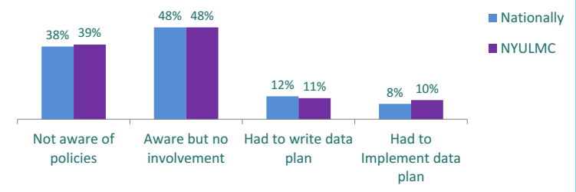
postdocs when surveyed asking “to what extent have you dealt with NIH data sharing regulations or NSF data management plans?”
Source: NYU Medical Library
Notes:
Don’t overlook the planning stage...

Slide 9
“Every minute you spend in planning saves 10 minutes in execution; this gives you a 1,000 percent return on energy!”
(Brian Tracy)
Notes:
Brain Tracy is an economist, go figure

Slide 10
data collection

Slide 11
Collection:
Where is the raw data?
Format and volume?
Methods?
Variables and units?
Assurance:
Validation or standards (instruments/data)
Missing values?
Plan
Discover
Collect
Assure
Share
Data Life Cycle
Analyze
Describe
Preserve
Source: Digital Curation Centre

Slide 12
data standards in practice
Data standards are the rules by which data are described and recorded. In order to share, exchange, and understand data, we must standardize the format as well as the meaning.
Source: OHSU Open Educational Resources

Slide 13
different definitions for ‘data standards’
"Standards are documented agreements containing technical specifications or other precise criteria to be used consistently as rules, guidelines, or definitions of characteristics to ensure that materials, products, processes, and services are fit for their purpose."
(International Organization for Standardization (ISO))
Source: OHSU Open Educational Resources

Slide 14
ways to standardize I
Data content standards
Data content standards are a standardized, pre-defined terminology that is used consistently throughout a dataset.
For example, when describing a variable, use the same terminology throughout, such as male/female for gender (as opposed to M/F, men/women, etc.)
Source: OHSU Open Educational Resources
Notes:
Can you think of other examples?

Slide 15
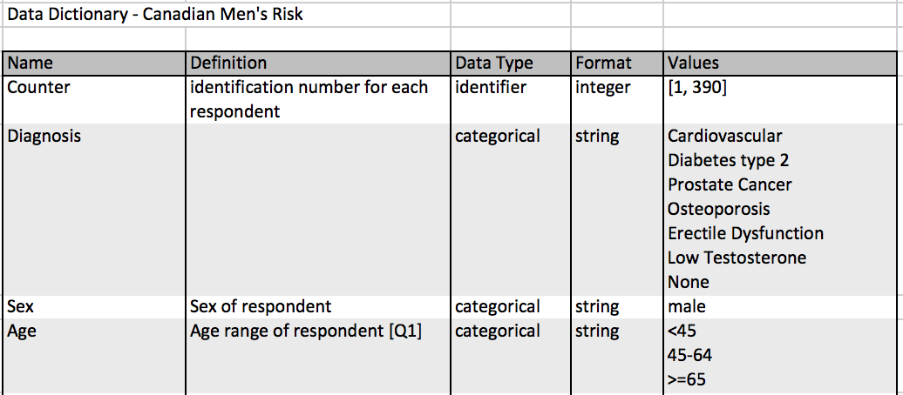
ways to standardize II
Data dictionary
The purpose of a data dictionary is to ensure consistent terminology throughout a dataset. It contains a list of descriptive data types that are being collected.
Example:
Source: OHSU Open Educational Resources

Slide 16
ways to standardize III
Data modeling
Data modeling is the a process that is typically performed before data collection. It involves identifying the user needs from the data set and determining the relationships among the data, and how the data should be best captured.
Source: OHSU Open Educational Resources

Slide 17
ways to standardize IV
Ontology
A controlled vocabulary that defines the terms in a given domain or knowledgebase, and the relationships between those terms.
Example:
Gene Ontology
Mammalian Phenotype Ontology
Source: OHSU Open Educational Resources

Slide 18
ways to standardize V
Metadata
Metadata is often referred to as “data about data”. Metadata is intended to describe other data, in order to clarify the meaning of a dataset. Metadata consists of both indexing terms (i.e., terms that can be used for search and retrieval of the data) and descriptive attributes.
Example:
Source: OHSU Open Educational Resources
Notes:
More on this at 4/5/17 workshop

Slide 19
after the data

Slide 20
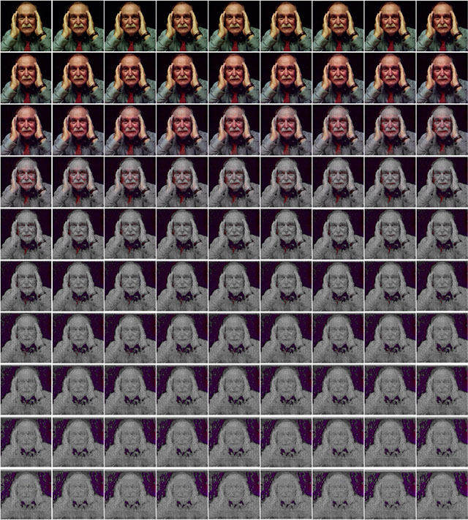
Notes:
Information loss is a real thing!!
http://petapixel.com/2015/02/11/experiment-shows-happens-repost-photo-instagram-90-times/

Slide 21
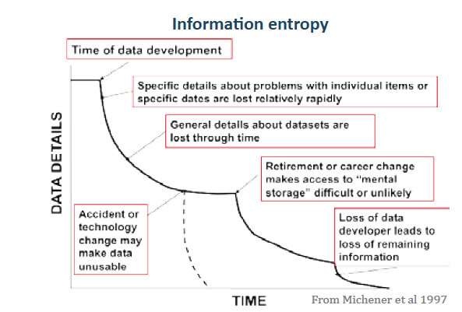
information loss
Notes:
full citation: Michener, W. K., Brunt, J. W., Helly, J. J., Kirchner, T. B. and Stafford, S. G. (1997), NONGEOSPATIAL METADATA FOR THE ECOLOGICAL SCIENCES. Ecological Applications, 7: 330–342.

Slide 22
“Your closest collaborator is you six months ago, but you don’t reply to emails…”
Notes:
Paraphrasing Mark Holder from KU (evolutionary biologist)

Slide 23
data management plan (dmp)
Description:
Descriptive details about the project & experiment
Preservation:
Back up schedule?
3 Back up locations?
How long to save it?
Sharing:
Public repository?
Sensitive data?
Analysis:
Tools (software)?
Plan
Discover
Collect
Assure
Share
Data Life Cycle
Analyze
Describe
Preserve

Slide 24
how do you describe your data?
Why are you doing this study?
Who is involved?
Where was the data collected?
What were the data collection processes
What do the values in the table mean?
What software is needed to view the data?
How should the data be cited?
README.txt
README.md
Notes:
Exercise: Add a README.txt to one of your folders to add some descriptive information.
Another way to avoid information loss, provide some context for someone who might “discover” your work – but think about what you would want if you came across someone else’s data.
AKA METADATA: This is good practice along with DMP but is typically a required component for data sharing via repositories

Slide 25
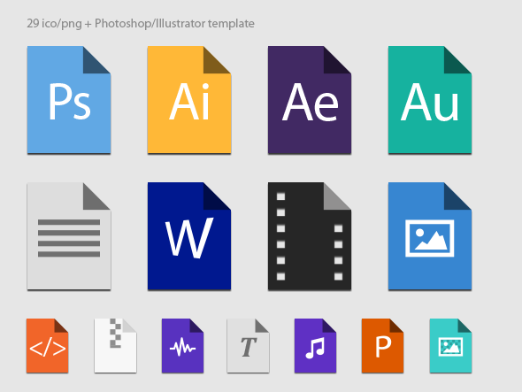
stable file formats
this | not that
.csv | .xls
.txt .html .rtf | .doc
.tiff .png | .jpg .gif
Notes:
One quick and dirty way to avoid info loss!

Slide 26
how will you store & backup the data?
Computer/Laptop
Network Drive
External Devices
Source: OHSU Open Educational Resources
Remote/Cloud
Physical Storage (e.g. notebooks)

Slide 27
how will you store & backup the data?
Storage option | The good | The bad
Computer/Laptop | Convenient for active data | Easily lost/stolen Fail Manual backup
Network | Automatic backup and security | Access Capacity limitations
External devices | Low cost Portable Easy to use | Easily lost/stolen Fail
Remote/Cloud | Global access Collaboration | Security/privacy limitations
Physical storage (e.g. notebooks) | Convenient Tangible | Manual backup
Source: OHSU Open Educational Resources

Slide 28
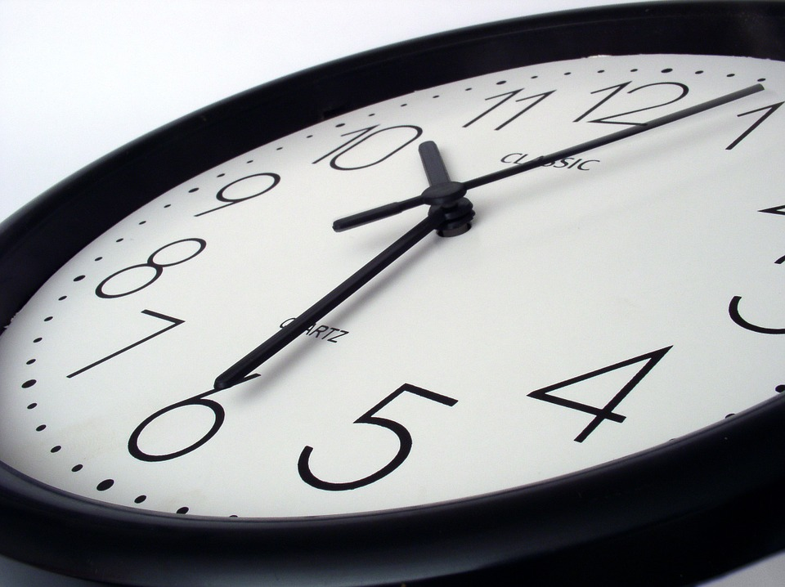
how long will you keep the data?

Slide 29
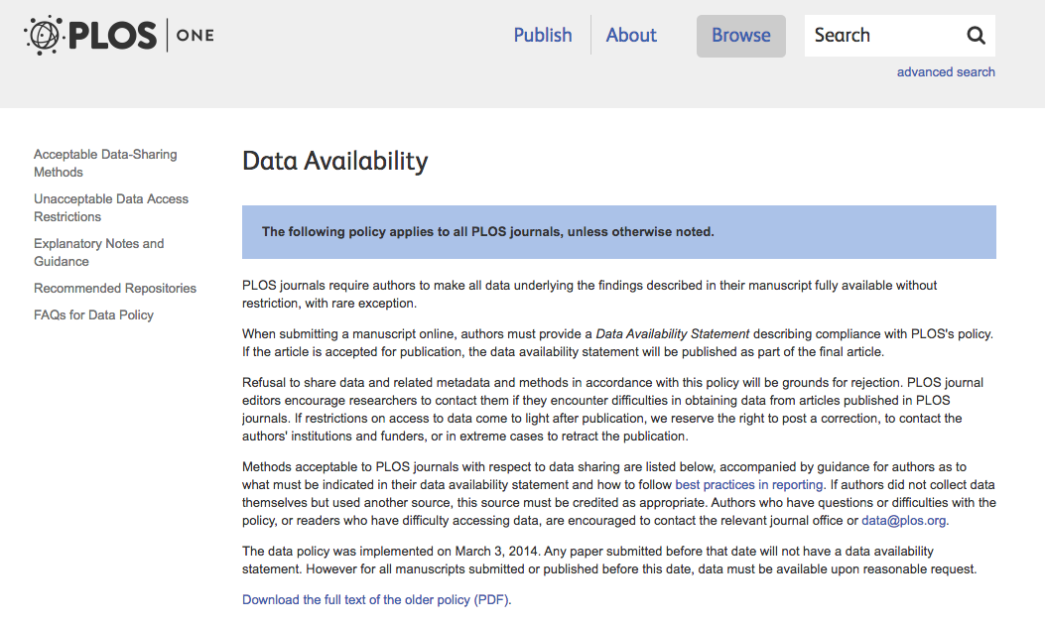
preservation & sharing
Source: PLOS Author Guidelines
Notes:
Exercise: Look up preservation/sharing requirements from relevant funders/publishers in your field – add link as an issue to the RPW repo
regulation is no joke:
plos guide: http://journals.plos.org/plosone/s/data-availability#loc-recommended-repositories
Challenging though:
HIPPA and anonymizing data!
There’s a cost
Upside is that it helps increase your impact (people cite data)

Slide 30
‘FAIR’ data principles
What is ‘FAIR’ data?
FINDABLE: persistent identifier, registered, rich metadata
ACCESSIBLE: retrievable by ID, metadata accessible
INTEROPERABLE: uses shared language, vocab is ’FAIR’, references other data
RE-USABLE: accurate attributes, released with data use license, standards are met, provenance available
Don’t forget about ‘FAIR’ metadata!
Keep in mind for how you might craft a better plan for your managing your data…
Source: Force 11

Slide 31
data plans - why should we care?

Slide 32

incentives
Maximize your research dollars by sharing and re-using data
Maximize your research impact by sharing data
Treat yo’self: general organization
Source: OHSU Open Educational Resources
Notes:
It’s in everyone’s best interest to document a data management plan

Slide 33


funding agency mandates
NIH
Data sharing plan for new proposals
Specific institutes and Centers have specific data sharing requirements
NSF
Requires a maximum 2 page data plan for data management and sharing of the products of research for all proposals
Source: OHSU Open Educational Resources
Notes:
Increased demand for data sharing

Slide 34
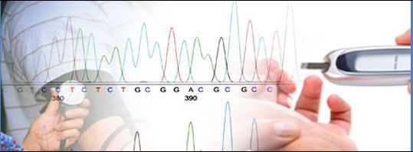


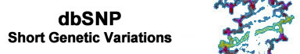
funding agency mandates
NIH/Genomic data
Source: OHSU Open Educational Resources
Notes:
Great resource: https://gds.nih.gov/PDF/Supplemental_Info_GDS_Policy.pdf

Slide 35
journal reporting requirements
Reporting requirements vary
Methods section is meant to contain enough information so someone could independently replicate your experiment
Some journals are starting to increase their standards
Source: OHSU Open Educational Resources

Slide 36
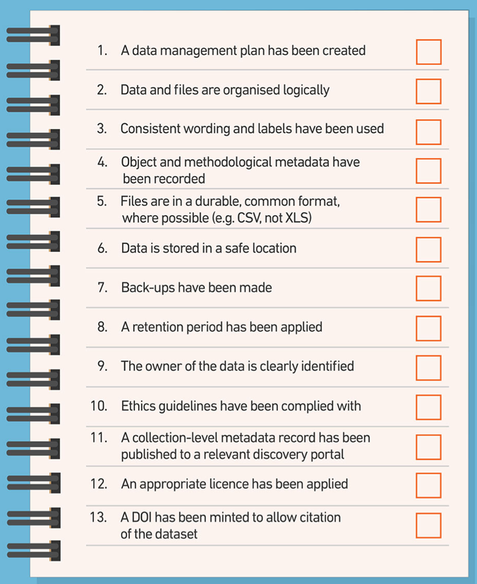
hang your checklist!
Notes:
Source: https://www.ersa.edu.au/data-management-checklist/

Slide 37
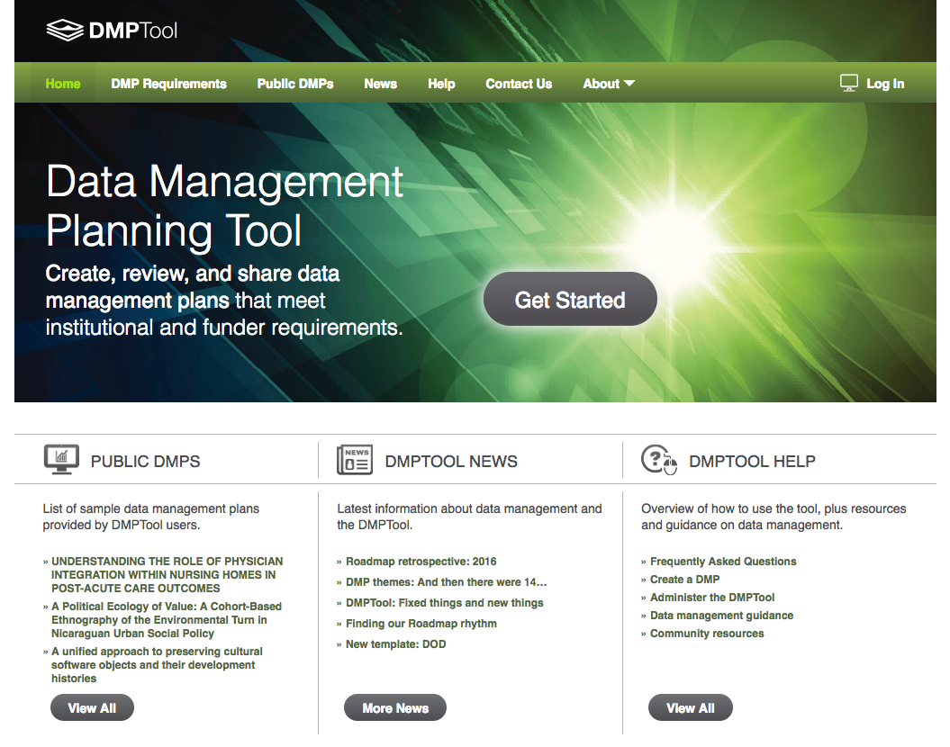
dmp tool
Source: DMPTool.org

Slide 38
your turn…

Slide 39
recap
1 Understand the elements of the data life cycle
2 Describe fundamental processes of research
data management (RDM)
3 Identify the components of a data
management plan and construct a draft

Slide 40
key resources
OHSU Big Data to Knowledge (BD2k) Open Educational Resources (OERs)
OHSU Library Data Webpage
OHSU RDM Librarian (1:1 consulting)
OHSU Library Workshops: Contact Us

Slide 41
questions?
Letisha R. Wyatt, PhD
wyattl@ohsu.edu
BICC 341
503.494.8627

